Slide 1
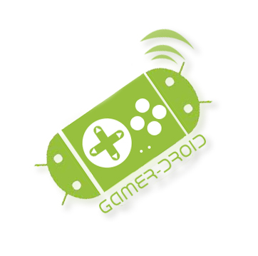
Gamer Droid Using Android as a Wireless Game Controller
Minor Project 7th semester
Sagar Rana
Piyush Chaudhary
Himanshi Girdhar
Abhinav Kr. Singh
MENTOR :
Ms. Savita
ahlawat
Notes:
This template can be used as a starter file for presenting training materials in a group setting.
Sections
Sections can help to organize your slides or facilitate collaboration between multiple authors. On the Home tab under Slides, click Section, and then click Add Section.
Notes
Use the Notes pane for delivery notes or to provide additional details for the audience. You can see these notes in Presenter View during your presentation.
Keep in mind the font size (important for accessibility, visibility, videotaping, and online production)
Coordinated colors
Pay particular attention to the graphs, charts, and text boxes.
Consider that attendees will print in black and white or grayscale. Run a test print to make sure your colors work when printed in pure black and white and grayscale.
Graphics, tables, and graphs
Keep it simple: If possible, use consistent, non-distracting styles and colors.
Label all graphs and tables.

Slide 2

Introduction
The basic idea of the project is to use an android device as a game controller so as to use the accelerometer (motion sensor) of the android device to play most of our games on PC .
Using this idea as our target, we will make an application for the android devices which will make the user feel like he/she is playing with a real motion sensing game controller.
Notes:
Give a brief overview of the presentation. Describe the major focus of the presentation and why it is important.
Introduce each of the major topics.
To provide a road map for the audience, you can repeat this Overview slide throughout the presentation, highlighting the particular topic you will discuss next.

Slide 3

Technologies to be used :
Language : Java
Tool : Android development kit
IDE:Eclipse.
Emulator : Android virtual device.
Notes:
This is another option for an overview using transitions to advance through several slides.

Slide 4
Functioning
Our project will be using wifi connection of android to establish a link between the application used as Client on Android phone and a server running on the computer the game is installed upon.
We are using the wifi ports of the computer and a signal would be send by the Droid Controller to the machine using the ports of computer ,this signal is recognised by the GamerDroid program running on the computer.
The goal is to make the controller generic so that it works for all games and cross-platform for all Operating Systems.

Slide 5
Phases of project
Phase – I
Development of Droid Application Environment.
Implementing a application in Android Version 2.1 with the use of Eclipse SDK Version: 3.5.2,with the required android -sdk and android development tookit plugin ,eclipse generates .apk files for android which constitutes of buttons which are directions for the current Game (for now Need For Speed).

Slide 6
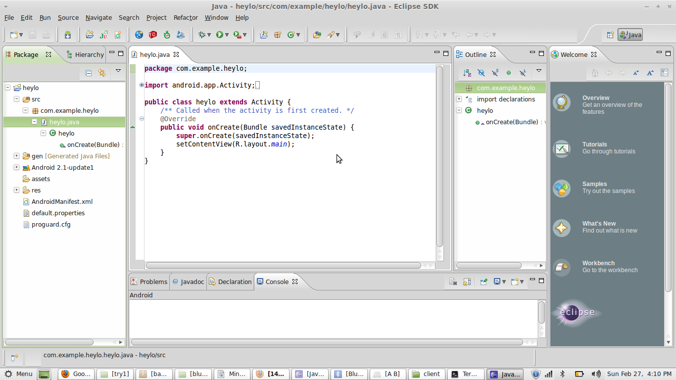
Development of Application in Eclipse

Slide 7
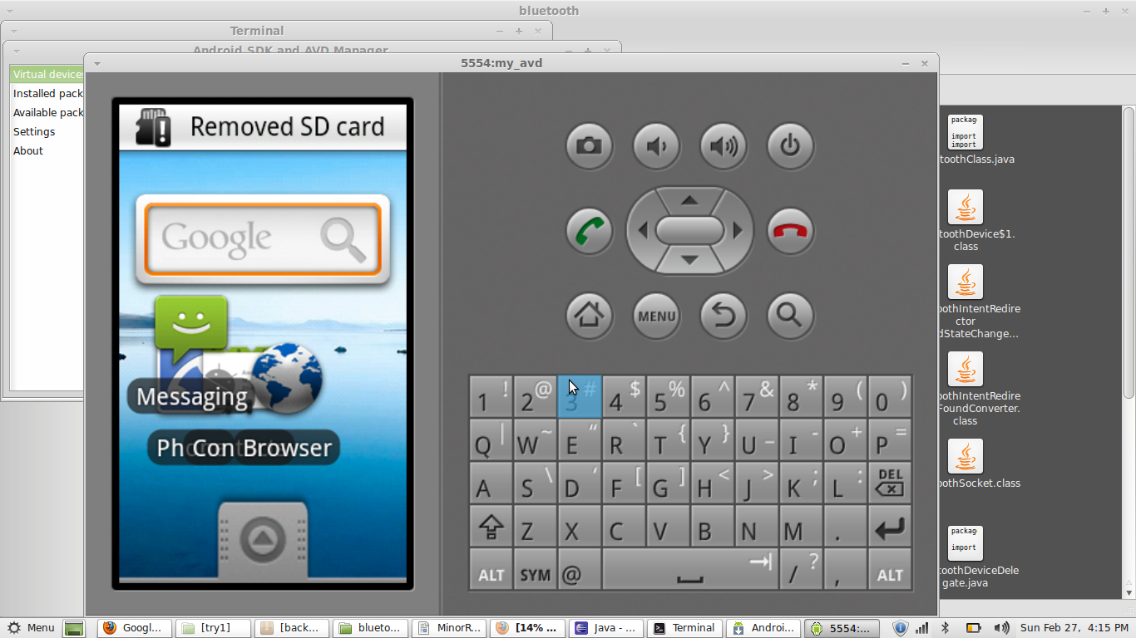
Emulator
W

Slide 8
Phase II
Establishment of link
We have to create Wifi hotspot in our laptop so as to turn it into a local server.
The next step is to establish a link between PC and “Gamer Droid” on mobile ,this step is one of the crucial steps.

Slide 9
Phase III
Game control
When the link is established between Android and PC,the big question is the use of game controls that will be used to operate the game.
With the help of “Gamer Droid” interface on the PC and various Java functions and classes ,the signal that the wifi link will bring would be used to see which key is pressed rather is the key pressed or not.

Slide 10
Say < | | > are directions for left,up,down and right in the game (say NFS) ,then if in the android “Gamer Droid” interface if button right is pressed then the game would read > and hence a right direction motion for the car will be implemented.
The interface of “GamerDroid” on the PC is used here and it is that interface used for recognition of buttons.

Slide 11
Phase iv
Implementing accelerometer
After studying and researching about accelerometer, we implemented the code.
Server was able to detect keys from the mobile’s accelerometer.
The application was ran and tested successfully on different android phones.

Slide 12
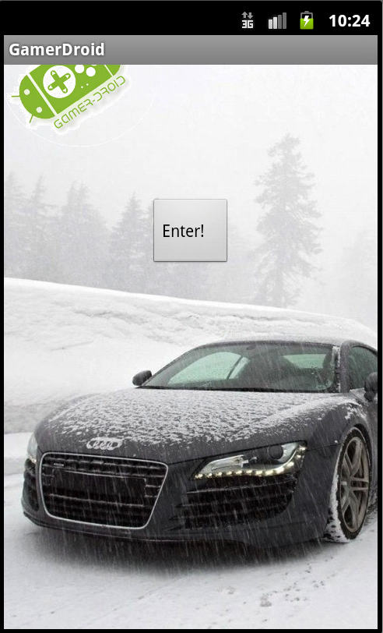
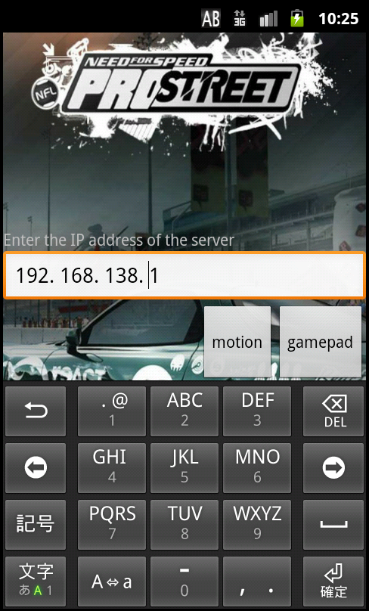
Some sceenshots of the test application

Slide 13
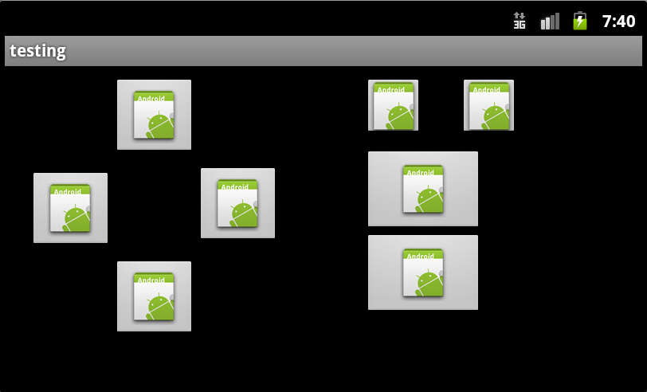
UP
RIGHT
ALT
SPACE
LEFT
DOWN

Slide 14
Features and highlights
The techniques used in developing GamerDroid are generic, so the controls can be used for any game.
The server side has been implemented in java, which by it’s very nature is cross platform and hence, GamerDroid can be used on any Operating system.
The structure of the application is such that it is divided into a number of independent, but communicating modules. So, the application never crashes as a whole.
The size of the programs is small, so neither the client, nor the server side hogs any space in the device.

Slide 15
Uniqueness and Future Scope
The project is a new concept and a revolution in the world of gaming,a new experience which has a wider access as it does not require any hardware component .
Our vision is to implement the same module for multiplayer games thus to only increase the pleasure ,we wish to implement multiple Droid connections with PC and hence unique and yet parallel transfer of signals through multiple Android connected through GamerDroid.

Slide 16
References
http://developer.android.com/
Head First Android Development : O’Reilly
For socket Programming
http://www.anddev.org/socket_programming-t325-s30.html
http://thinkandroid.wordpress.com/
http://www.anddev.org
http://www.android.bigsource.com/

